Slide 1
Webex and The Future: AI
Presented by Kelli Holmes

Slide 2
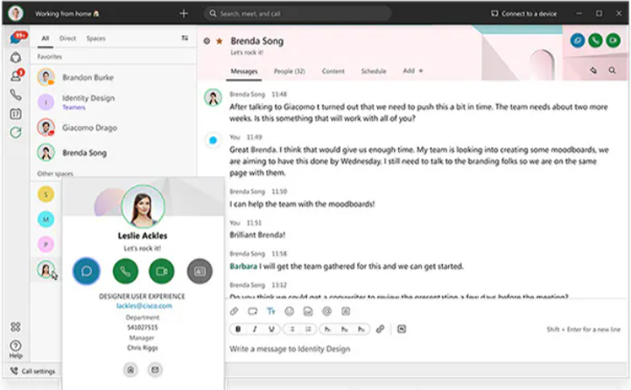
History
Cisco acquired WebEx in 2007
The tool provided businesses with a platform for hosting video/audio meetings
Usage of whiteboard during meetings
Ability to share your screen
Ability to record meetings
Ability to do live polling during meetings using Slido.

Slide 3
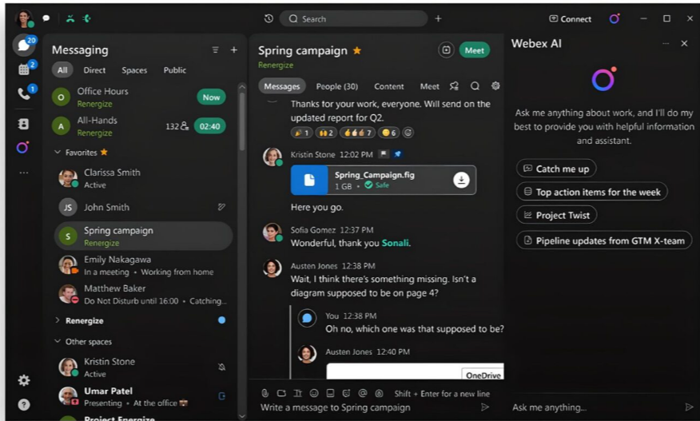
The intro of AI: Webex
AI was first introduced in 2017 in Webex
Webex initially used AI to remove the background noises like dogs barking, or doorbells going off.
Webex used AI to automatically frame up participants as they talked as a closeup.
Conversational AI was created in 2018 which utilized the first voice activated assistant that allowed for meetings to be started, sharing of a screen, or help you call someone all without doing anything.

Slide 4

Before AI
Notes from meetings would need to manually be taken
Background noise would be heard
There was no ability to change the tone of what you were trying to say.
No option to change communicated language

Slide 5
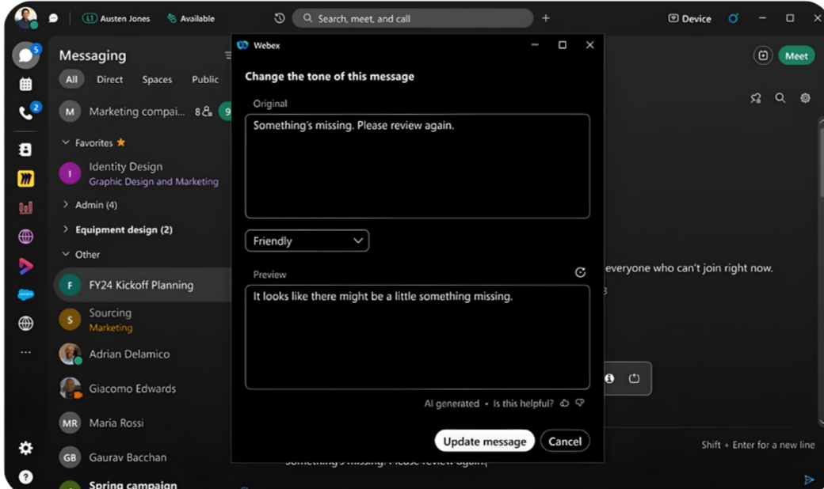
After AI
Tone of the message you are sending can be changed
In meetings background noise is muted.
No language barriers, with AI communication issues have become an issue of the past

Slide 6
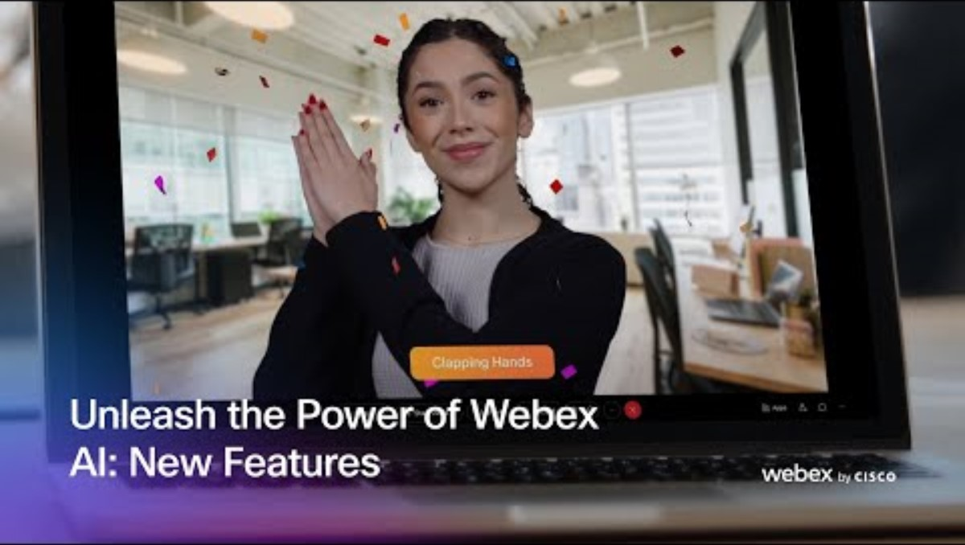
Highlights of Webex ai assistant

Slide 7
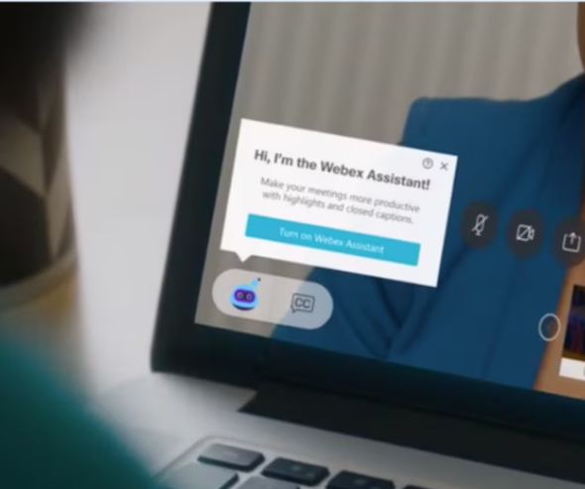
The outlook of AI with webex
Webex meetings will only continue to be more effective.
Presentations will continue to improve with support of AI Assistant
It will continue to improve our communication with people that speak other languages.

Slide 8
References
Dhingra, A. (2023, November 20). Collaboration in the age of AI: How cisco is pioneering the use of AI and Emerging Technology within collaboration. Webex Blog. https://blog.webex.com/collaboration/video-conferencing/collaboration-in-the-age-of-ai-how-cisco-is-pioneering-the-use-of-ai-and-emerging-technology-within-collaboration/
Khan, J. (2024, March 26). Introducing the most advanced AI-powered platform for making hybrid work, work. . Webex Blog. https://blog.webex.com/innovation-ai/advanced-ai-powered-hybrid-work- platform/
Rowen, C. (2024, September 18). The latest Webex AI features empowering the Future of Work. Webex Blog. https://blog.webex.com/collaboration/hybrid-work/the-latest-webex-ai-features-empowering-the-future-of-work/

